Slide 1
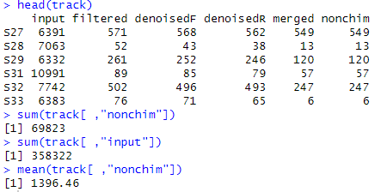

Slide 2
90 fungal OTUs
5 fungal OTUs per sample
27.8% could not be identified to class.
54.4% could not be identified to genus
21 ECM Fungal OTUs
2 ECM Fungal OTUs per sample

Slide 3
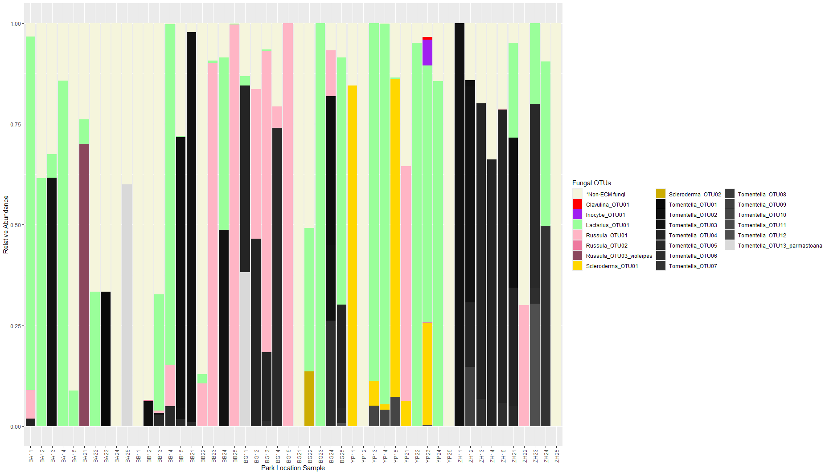

Slide 4
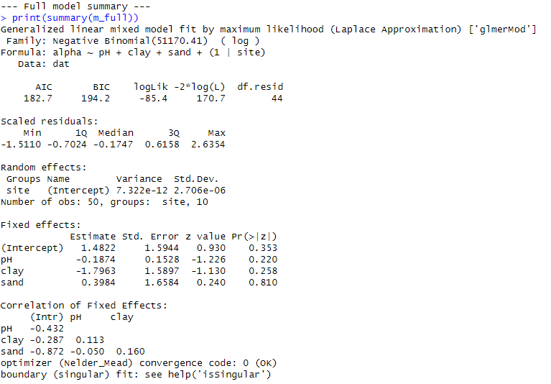

Slide 5
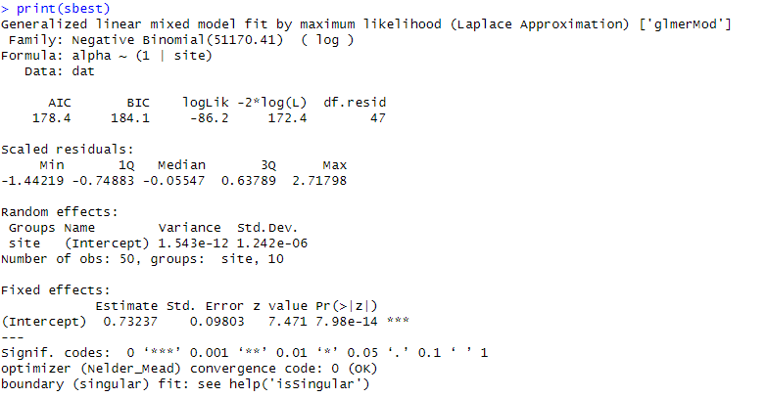

Slide 6
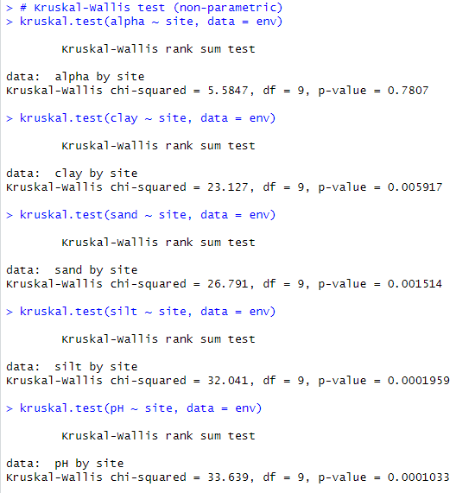

Slide 7
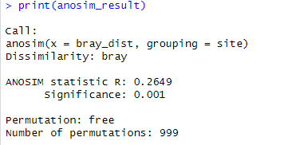

Slide 8
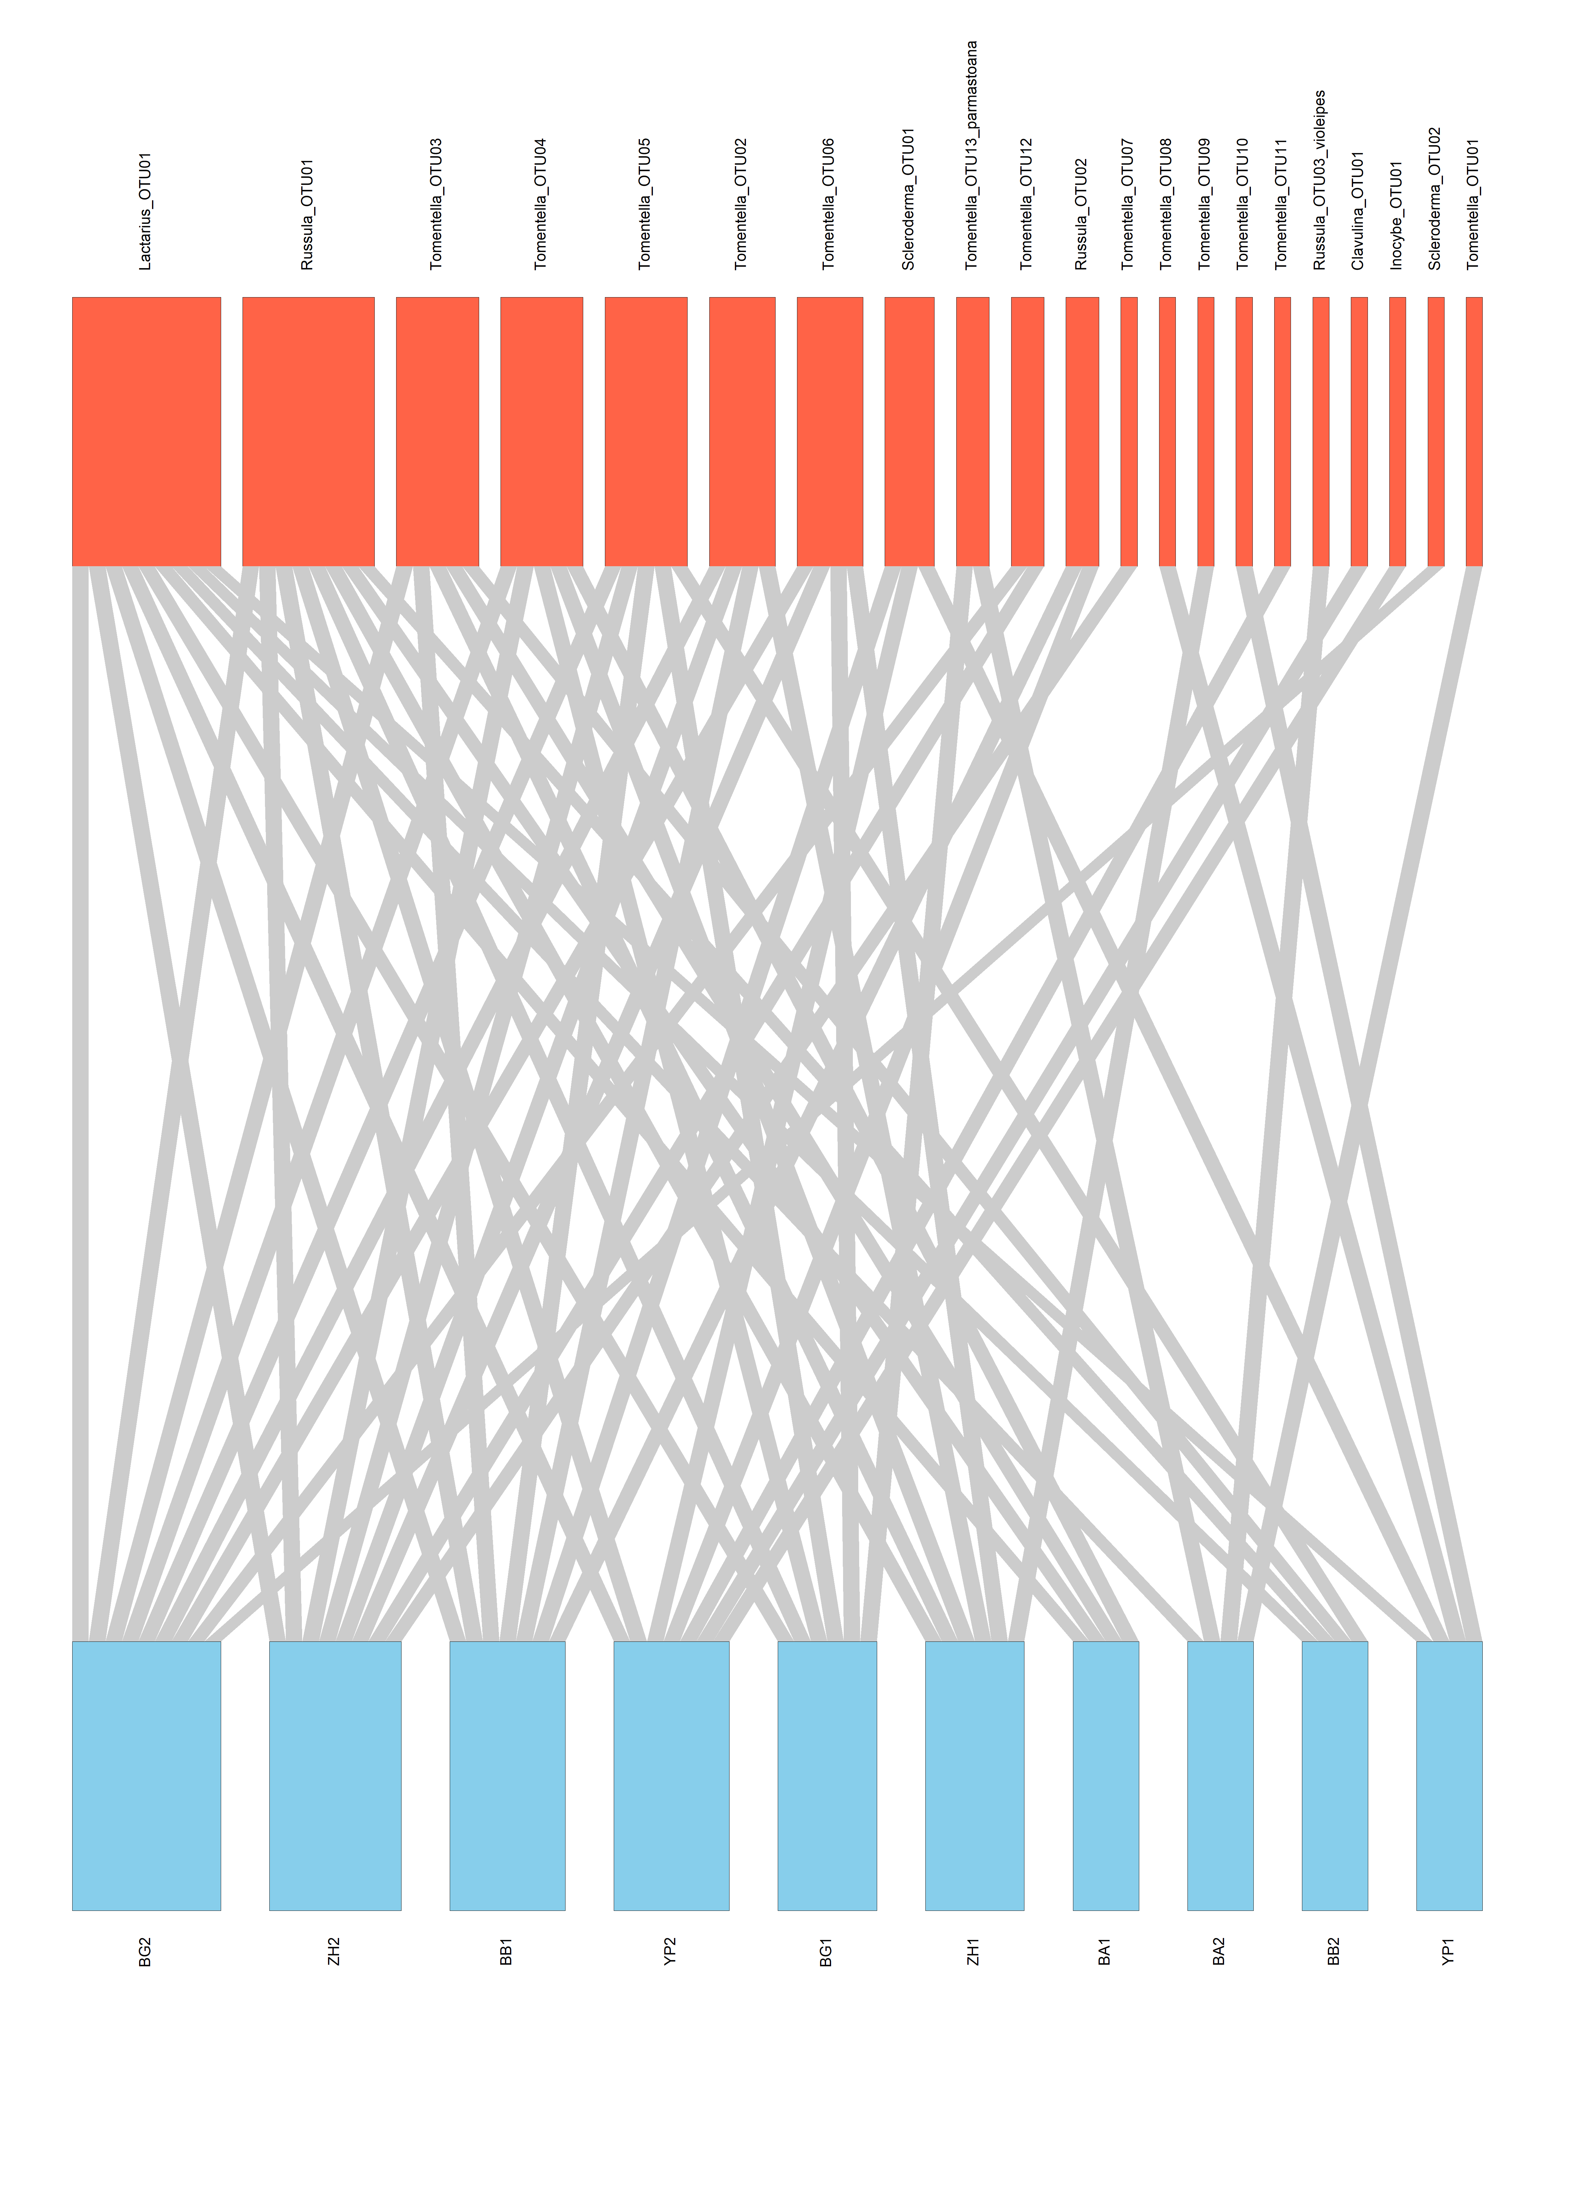
Park Locations
ECM Fungal OTUs

